Slide 1
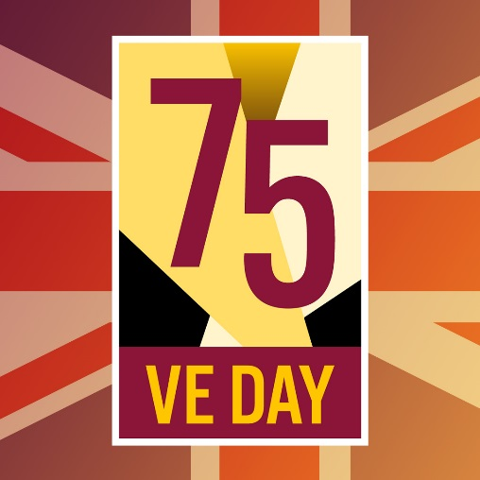

VE DAY
8TH MAY 1945
75TH ANNIVERSARY
8TH MAY 2020

Slide 2

Use the following pages to help celebrate VE Day. Take a look at the information, recipes and ideas to commemorate the occasion. Remember to incorporate the social distancing rules to ensure a good time for all.
Information collated from English Heritage, Colouring for Heroes, Joe Mann, Doodles of Art & Food Teachers Centre.
What is VE Day?
Friday 8 May 2020 marks 75 years since Nazi Germany's formal surrender at the end of the Second World War. On VE (Victory in Europe) Day in 1945, millions took to the streets to celebrate peace after years of devastating war.
The Allies had originally agreed to mark 9 May 1945 as VE Day. But news of Germany’s surrender was leaked and spread across the world like wildfire, sparking impromptu celebrations.
Perhaps understandably, Britain did not want to wait. After years of loss, destruction and heartache, people were eager to rejoice at the prospect of a peaceful Europe. And so, late on 7 May, a BBC radio news flash announced that the next day would be a national holiday.

Slide 3
Use the following pages to help celebrate VE Day. Take a look at the information, recipes and ideas to commemorate the occasion. Remember to incorporate the social distancing rules to ensure a good time for all.
Information collated from English Heritage, Colouring for Heroes, Joe Mann, Doodles of Art & Food Teachers Centre.
How did people celebrate?
People held street parties in celebration and in thanks that the war was over.
Mass gatherings occurred in public areas such as Trafalgar Square with people waving red, blue and white flags or the Union Jack.
They sang songs together such as the now iconic “We’ll Meet Again”, “Doing the Lambeth Walk” and “White Cliffs of Dover”.
St Paul’s Cathedral held ten consecutive services in thanks for peace.
Licensing hours were extended so that people could properly toast the end of the war, and dance halls remained open beyond usual closing hours to accommodate buoyant revellers.

Slide 4
Use the following pages to help celebrate VE Day. Take a look at the information, recipes and ideas to commemorate the occasion. Remember to incorporate the social distancing rules to ensure a good time for all.
Information collated from English Heritage, Colouring for Heroes, Joe Mann, Doodles of Art & Food Teachers Centre.
What did they eat at the parties?
Due to the fact that rationing was still in existence (and would be for a few years after the war), people had to be creative with their ideas for street food at the party, much like some of us have to be at the moment during the current lockdown.
Sandwiches were the main order of the day during the VE Day street party celebrations, as was beer (until it ran out early in the pubs, well before the 10.30pm curfew).
Sweet treats weren’t totally off limits, but you had to be a little more ingenious because of limited ingredients. Eggs were rationed so people had to learn how to bake without them, and anything with the also rationed sugar was saved for a very special day.

Slide 5
Check out these links for other ideas for celebrating over the weekend:
https://www.english-heritage.org.uk/siteassets/home/visit/ve-day-75/eh-ve-day-at-home-pack.pdf
https://www.bbc.co.uk/programmes/articles/4TrqYDyf4PMdLypxzyTwGDg/great-british-bunting
Some key timings that you may want to observe on the day:
11am: 2 minute silence (British Legion)
3pm: Listen to Churchill’s speech and undertake the Nation’s Toast to the Heroes of WW II, using the following
words. “TO THOSE WHO GAVE SO MUCH, WE THANK YOU”
4-6pm: Street Party – you could: dress up in red, white and blue or 40’s clothes, decorate the front window,
play some music, put out tables and chairs keeping to the 2m rule, make your own picnic food.
9pm: Queen’s speech, following by nationwide singalong to “We’ll Meet Again”

Slide 6
Things to watch/take part in:
9am: Voices of War – experience Imperial War Museums’ soundscape featuring the recollections of people who witnessed VE Day. Visit iwm.org.uk and follow IWM on Twitter and Facebook.
11am: The official commemorations will begin with a national moment of remembrance and a two minute silence.
12 noon: Learn to Lindy Hop with English Heritage’s live dance tutorial. Nancy Hitzig will help you get the hang of this popular wartime craze. Sign up now!
2pm: Give yourself a Second World War-inspired makeover with English Heritage’s 1940s makeup tutorial
2pm: Take part in The National Museum of the Royal Navy, the National Army Museum and the Royal Air Force Museums’ live webinar with renowned historian James Holland and National Army Museum curator Dr Peter Johnson to discuss the events that brought the Second World War in Europe to an end in 1945. Register now
3pm: Extracts from Sir Winston Churchill’s victory speech will recreate the moment peace in Europe was announced 75 years ago and the Prime Minister will speak about the importance of VE Day.
4pm: VE Day 75 Anniversary watch live as Dan Snow takes us through the events as they happened. He’ll also be showcasing some of your creative entries as part of his VE Day Creative Challenge.
4pm: Victory Dance Class with SwingdanceUK, teaching you to Jitterbug and Jive from the safety of your own home in this live beginners’ dance class. Register now.
5pm: Show off your moves and join others from around the world in an English Heritage dance-along, complete with a Lindy Hop dance troupe and band
5.30pm: Get your singing voices at the ready and tune in to Gareth Malone’s #GreatBritishHomeChorus on YouTube for a VE Day special performance.
6pm: We’ll Meet Again for VE Day 75 with Katherine Jenkins. The Royal Albert Hall will host to a very special concert behind closed doors streamed on their YouTube channel. Set a reminder to watch live
9pm: Her Majesty The Queen will send a message to the nation at 9pm, the exact moment her father, King George VI, gave a radio address in 1945.
9:10pm: Join your neighbours on your doorstep to take part in the national singalong of Dame Vera Lynn’s ‘We’ll Meet Again’

Slide 7
1940s MUSIC AND DANCE
SING-ALONG
WE’LL MEET AGAIN
We'll meet again
Don't know where
Don't know when
But I know we'll meet again
Some sunny day
Keep smiling through
Just like you always do
'Till the blue skies chase
Those dark clouds far away
And I will just say hello
To the folks that you know
Tell them you won't be long
They'll be happy to know
That, as I saw you go
You were singing this song
We'll meet again
Don't know where
Don't know when
But I know we'll meet again
Some sunny day
And I will just say hello
To the folks that you know
Tell them you won't be long
They'll be happy to know
That, as I saw you go
You were singing this song
We'll meet again
Don't know where
Don't know when
But I know we'll meet again
Some sunny day
LAMBETH WALK
Any time you’re Lambeth way
Any evening, any day.
You’ll find us all,
Doing the Lambeth Walk - oi!
Every little Lambeth gal,
With her little Lambeth pal.
You’ll find ‘em all
Doin’ the Lambeth Walk - oi!
Everything free and easy,
Do as you darn well pleasy.
Why don’t you make your way there
Go there, stay there.
Once you get down Lambeth way
Every evening, every day,
You’ll find yourself
Doin’ the Lambeth Walk - oi!
WHITE CLIFFS OF DOVER
There’ll be bluebirds over,
The white cliffs of Dover,
Tomorrow, just you wait and see.
There’ll be love and laughter,
And peace ever after,
Tomorrow when the world is free.
The shepherd will tend his sheep,
The valley will bloom again.
And Jimmy will go to sleep,
In his own little room again.
There’ll be blue birds over,
The white cliffs of Dover,
Tomorrow, just you wait and see

Slide 8


Slide 9


Slide 10


Slide 11
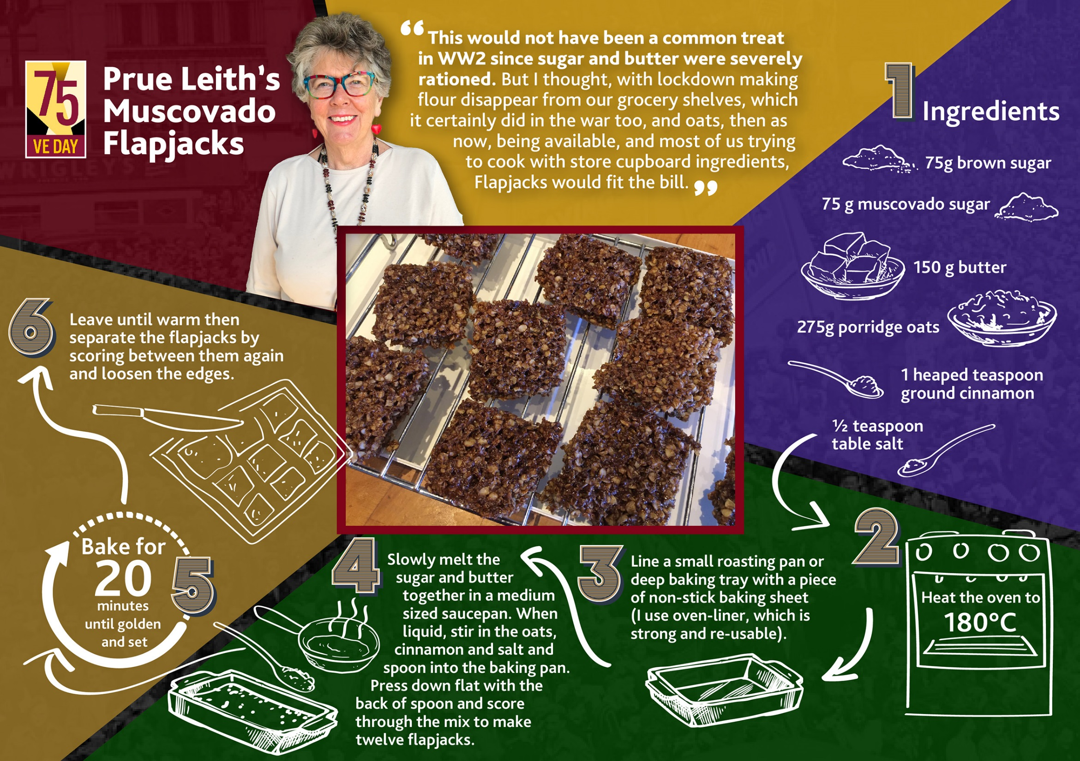

Slide 12
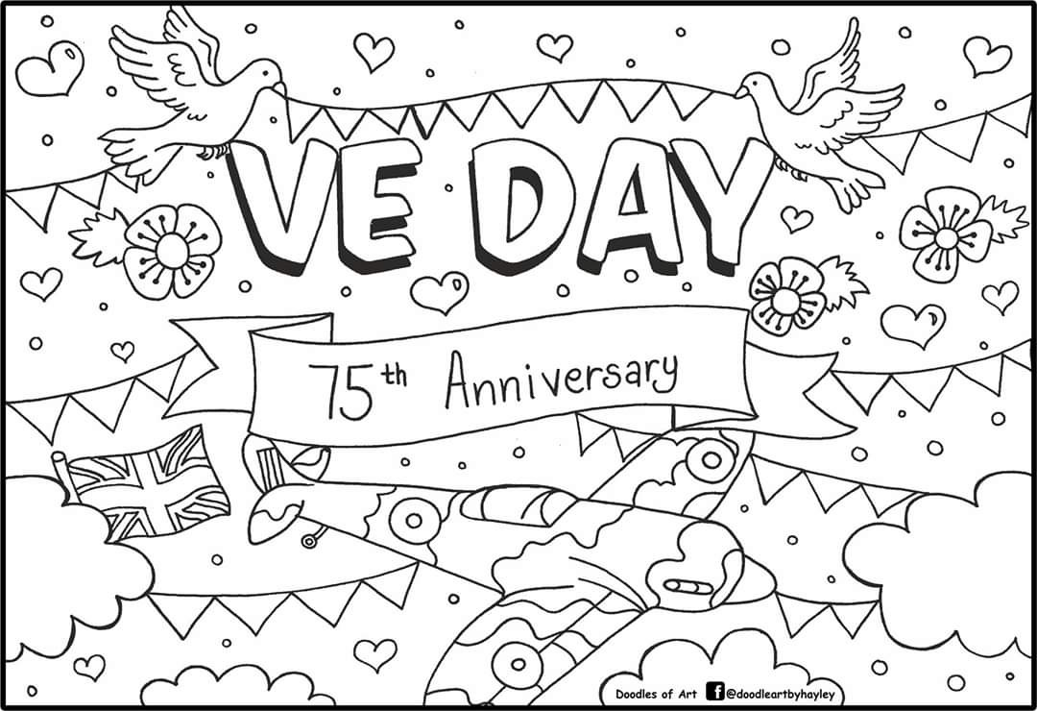

Slide 13
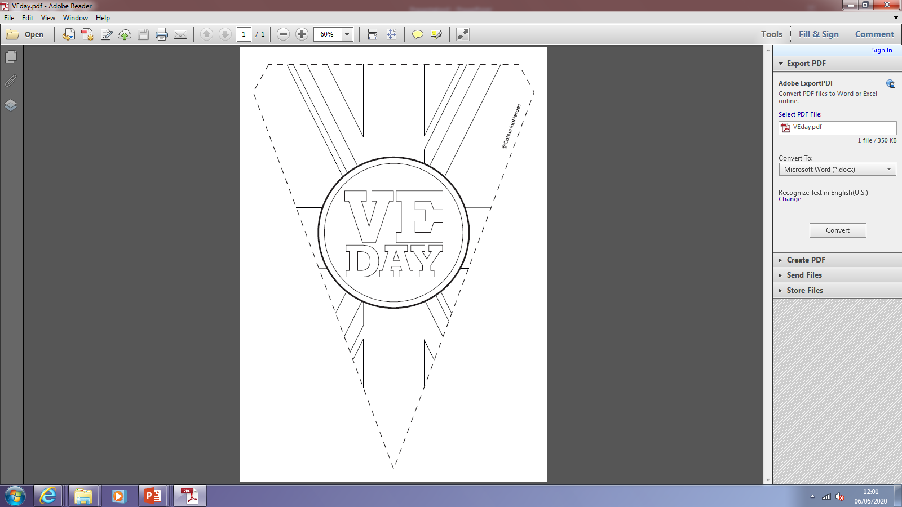

Slide 14
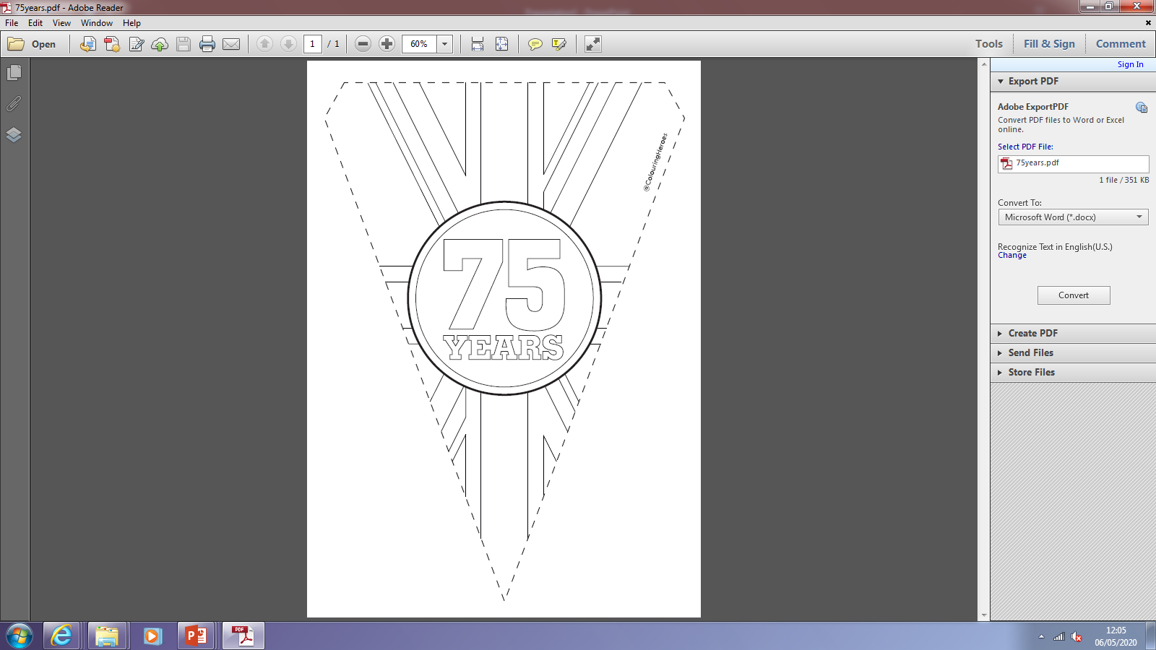

Slide 15
