Slide 1
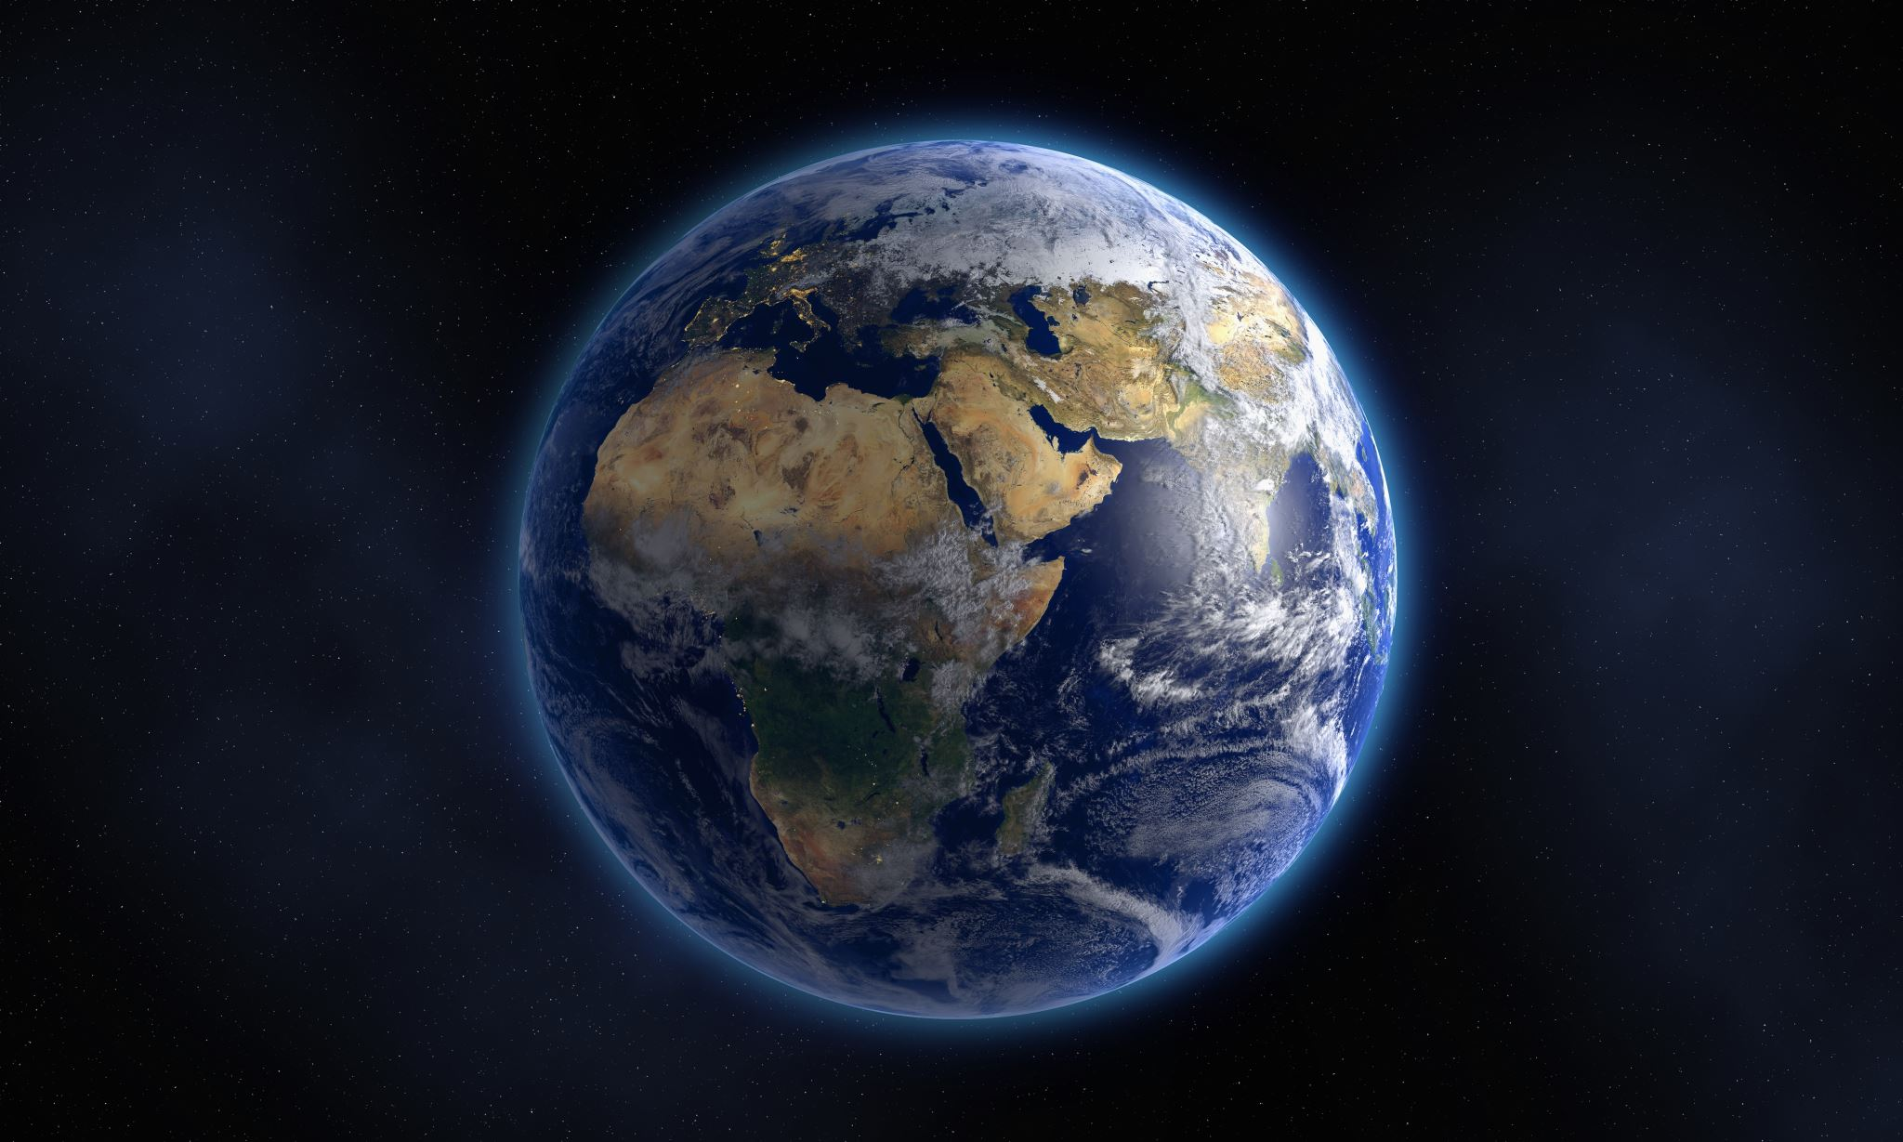
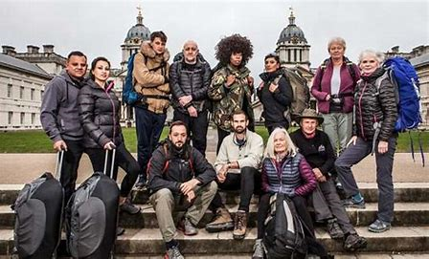

Race across the world
Geography summer learning project
Watch this clip!
https://www.bing.com/videos/search?q=you+tube+race+across+the+world+series+1&&view=detail&mid=52E301552760802370A452E301552760802370A4&&FORM=VRDGAR&ru=%2Fvideos%2Fsearch%3Fq%3Dyou%2Btube%2Brace%2Bacross%2Bthe%2Bworld%2Bseries%2B1%26go%3DSearch%26qs%3Dds%26form%3DQBVDMH

Slide 2
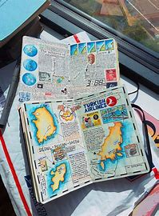
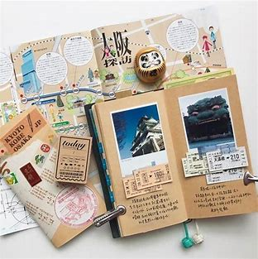
Your challenge for the last few weeks All Hallows Geographers is to complete a
RACE ACROSS THE WORLD PROJECT!
You will be creating your own route between 2 places in the world and presenting information about your own travel adventure in a journal! The next slides will tell you what your route will be. They will also explain what to include and how you can present your work.
If you need more inspiration before you start you can watch the first programme of “Race across the world” on BBCiplayer
https://www.bbc.co.uk/iplayer/episode/m000319z/race-across-the-world-series-1-episode-1

Slide 3
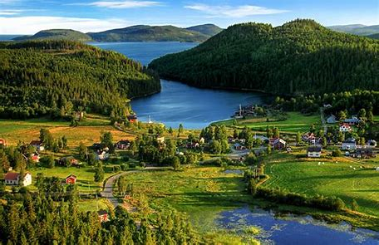
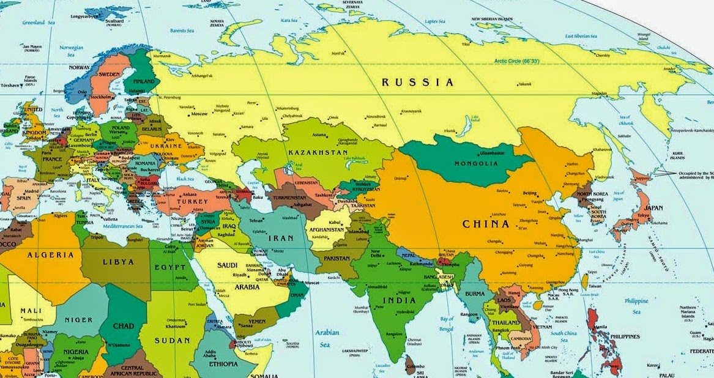
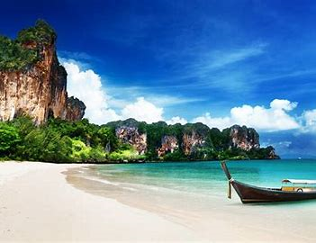

You will need to plan a route between Sweden and
Thailand! the route must be across land and sea -
It must not use air travel!

Slide 4
What do I need to include in my work?
1. Information on each country which you visit on the route such as the name of 3 major cities, its climate, the language spoken in each country, the currency you’ll need..
2. Pictures and key facts about 3 places of interest which you will visit in each country along your route.
Think of things you might want to visit- beaches? mountains? lakes? National Parks? football stadiums? museums?
3. Include other geographical data which will help you planning your trip- Climate graphs showing the hottest or wettest month to visit, graphs showing the major industries of each country, population pyramids.
4. A map showing your plotted route and information underneath showing the modes of transport you might use at each stage of the journey.

Slide 5
How will I present my work?
You can present your work on a poster, in your book, powerpoint, word or publisher.
Start off by plotting your route .
Then look at each country in turn along the way and write a paragraph about its key features and places to visit. Don’t forget to include photos or drawings!
You can pick any countries along the route. The choice is yours! They may even be places you would like to visit in the future so this project task gives you the opportunity to think BIG! (there is an example on the next slide!)

Slide 6
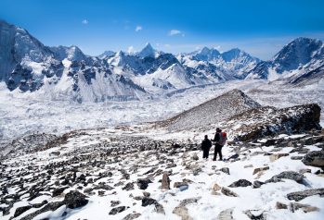
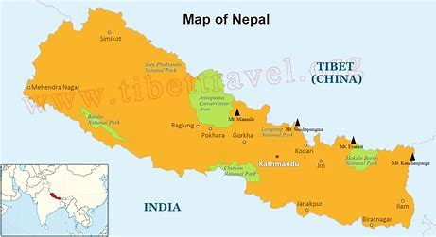
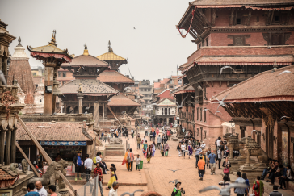
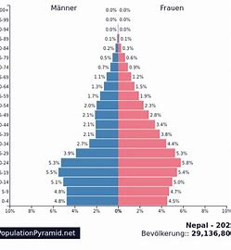
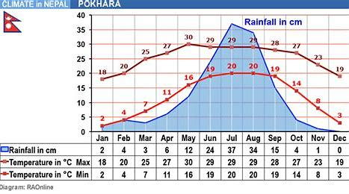

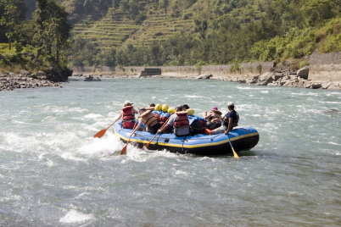

How you can present information about 1 country along your route…..
Nepal- My 8th Country
Nepal is a country where many people live at a very high altitude as it is very mountainous. It is located north east of India. It’s climate is cold up in the mountains but warmer in the lower regions. It has a lot of rain between July and September whilst the average temperatures can range from between below zero to 30 degrees maximum in the summer months.
1
2
3 major cities – Kathmandu, Lalitpur, and Pokhara.
Places I’d like to visit here…
1- Sagarmatha National Park which is where Mount Everest is. The mountain ranges are home to some of the world’s rarest species such as the snow leopard, the red panda, and Himalayan black bear
2. Patan – also called the ‘City of Beauty.’ The ancient part of the city is known for having some the best examples of traditional architecture in all of Nepal.
3. Bhote Koshi River – where I can go white water rafting!!
There are over 100 languages spoken in Nepal with Nepali as the official language of the country. Below are some phrases which I might use for my visit here:-
Do you speak English?=
Tapaai Angreji bolnuhunchha?
Thank you =Dhanyabaad
Hello = Namaste
Nepal has an area of 57,000 square miles, which is slightly more than England and is dominated by the largest mountain range in the world, the Himalayas. There are large areas where ice and snow dominate the landscape, and animals such as the snow leopard live but in other areas, grassy plains that can become very hot in the summer. Rhinos and wild buffalo roam live in this landscape. In between these extremes you can find alpine meadow and pine and rhododendron forests that are home to wild goats. A fifth of the country is suitable for farming, and is usually used for growing rice. The north west of the country is less densely populated because of the high mountains in this area. The population is a younger population than can be found in other more developed countries like Japan and the UK.
TRANSPORT= bus, taxi, rickshaw
CURRENCY= Nepalese Rupee
3

Slide 7
Template to help you set out each page!
Climate and landscape | (pictures/ maps/ diagrams)
Population
Transport / Currency
3 major cities and places I’d like to visit
Language and helpful phrases
Anything else

